Slide 1
Software Development Life Cycle (SDLC)
“You’ve got to be very careful if you don’t know where you’re going, because you might not get there.”
Yogi Berra

Slide 2
Capability Maturity Model (CMM)
A bench-mark for measuring the maturity of an organization’s software process
CMM defines 5 levels of process maturity based on certain Key Process Areas (KPA)

Slide 3
CMM Levels
Level 5 – Optimizing (< 1%)
-- process change management
-- technology change management
-- defect prevention
Level 4 – Managed (< 5%)
-- software quality management
-- quantitative process management
Level 3 – Defined (< 10%)
-- peer reviews
-- intergroup coordination
-- software product engineering
-- integrated software management
-- training program
-- organization process definition
-- organization process focus
Level 2 – Repeatable (~ 15%)
-- software configuration management
-- software quality assurance
-- software project tracking and oversight
-- software project planning
-- requirements management
Level 1 – Initial (~ 70%)

Slide 4
SDLC Model
A framework that describes the activities performed at each stage of a software development project.

Slide 5
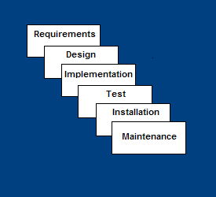
Waterfall Model
Requirements – defines needed information, function, behavior, performance and interfaces.
Design – data structures, software architecture, interface representations, algorithmic details.
Implementation – source code, database, user documentation, testing.

Slide 6
Waterfall Strengths
Easy to understand, easy to use
Provides structure to inexperienced staff
Milestones are well understood
Sets requirements stability
Good for management control (plan, staff, track)
Works well when quality is more important than cost or schedule

Slide 7
Waterfall Deficiencies
All requirements must be known upfront
Deliverables created for each phase are considered frozen – inhibits flexibility
Can give a false impression of progress
Does not reflect problem-solving nature of software development – iterations of phases
Integration is one big bang at the end
Little opportunity for customer to preview the system (until it may be too late)

Slide 8
When to use the Waterfall Model
Requirements are very well known
Product definition is stable
Technology is understood
New version of an existing product
Porting an existing product to a new platform.

Slide 9
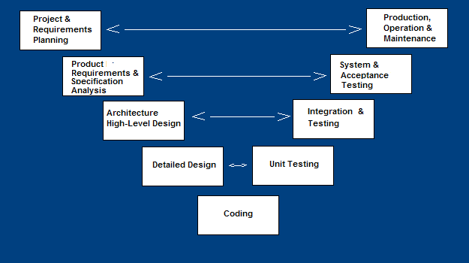
V-Shaped SDLC Model
A variant of the Waterfall that emphasizes the verification and validation of the product.
Testing of the product is planned in parallel with a corresponding phase of development

Slide 10
V-Shaped Steps
Project and Requirements Planning – allocate resources
Product Requirements and Specification Analysis – complete specification of the software system
Architecture or High-Level Design – defines how software functions fulfill the design
Detailed Design – develop algorithms for each architectural component
Production, operation and maintenance – provide for enhancement and corrections
System and acceptance testing – check the entire software system in its environment
Integration and Testing – check that modules interconnect correctly
Unit testing – check that each module acts as expected
Coding – transform algorithms into software

Slide 11
V-Shaped Strengths
Emphasize planning for verification and validation of the product in early stages of product development
Each deliverable must be testable
Project management can track progress by milestones
Easy to use

Slide 12
V-Shaped Weaknesses
Does not easily handle concurrent events
Does not handle iterations or phases
Does not easily handle dynamic changes in requirements
Does not contain risk analysis activities

Slide 13
When to use the V-Shaped Model
Excellent choice for systems requiring high reliability – hospital patient control applications
All requirements are known up-front
When it can be modified to handle changing requirements beyond analysis phase
Solution and technology are known

Slide 14
Structured Evolutionary Prototyping Model
Developers build a prototype during the requirements phase
Prototype is evaluated by end users
Users give corrective feedback
Developers further refine the prototype
When the user is satisfied, the prototype code is brought up to the standards needed for a final product.

Slide 15
Structured Evolutionary Prototyping Steps
A preliminary project plan is developed
An partial high-level paper model is created
The model is source for a partial requirements specification
A prototype is built with basic and critical attributes
The designer builds
the database
user interface
algorithmic functions
The designer demonstrates the prototype, the user evaluates for problems and suggests improvements.
This loop continues until the user is satisfied

Slide 16
Structured Evolutionary Prototyping Strengths
Customers can “see” the system requirements as they are being gathered
Developers learn from customers
A more accurate end product
Unexpected requirements accommodated
Allows for flexible design and development
Steady, visible signs of progress produced
Interaction with the prototype stimulates awareness of additional needed functionality

Slide 17
Structured Evolutionary Prototyping Weaknesses
Tendency to abandon structured program development for “code-and-fix” development
Bad reputation for “quick-and-dirty” methods
Overall maintainability may be overlooked
The customer may want the prototype delivered.
Process may continue forever (scope creep)

Slide 18
When to use Structured Evolutionary Prototyping
Requirements are unstable or have to be clarified
As the requirements clarification stage of a waterfall model
Develop user interfaces
Short-lived demonstrations
New, original development
With the analysis and design portions of object-oriented development.

Slide 19
Rapid Application Model (RAD)
Requirements planning phase (a workshop utilizing structured discussion of business problems)
User description phase – automated tools capture information from users
Construction phase – productivity tools, such as code generators, screen generators, etc. inside a time-box. (“Do until done”)
Cutover phase -- installation of the system, user acceptance testing and user training

Slide 20
RAD Strengths
Reduced cycle time and improved productivity with fewer people means lower costs
Time-box approach mitigates cost and schedule risk
Customer involved throughout the complete cycle minimizes risk of not achieving customer satisfaction and business needs
Focus moves from documentation to code (WYSIWYG).
Uses modeling concepts to capture information about business, data, and processes.

Slide 21
RAD Weaknesses
Accelerated development process must give quick responses to the user
Risk of never achieving closure
Hard to use with legacy systems
Requires a system that can be modularized
Developers and customers must be committed to rapid-fire activities in an abbreviated time frame.

Slide 22
When to use RAD
Reasonably well-known requirements
User involved throughout the life cycle
Project can be time-boxed
Functionality delivered in increments
High performance not required
Low technical risks
System can be modularized

Slide 23
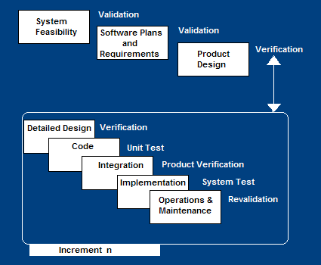
Incremental SDLC Model
Construct a partial implementation of a total system
Then slowly add increased functionality
The incremental model prioritizes requirements of the system and then implements them in groups.
Each subsequent release of the system adds function to the previous release, until all designed functionality has been implemented.

Slide 24
Incremental Model Strengths
Develop high-risk or major functions first
Each release delivers an operational product
Customer can respond to each build
Uses “divide and conquer” breakdown of tasks
Lowers initial delivery cost
Initial product delivery is faster
Customers get important functionality early
Risk of changing requirements is reduced

Slide 25
Incremental Model Weaknesses
Requires good planning and design
Requires early definition of a complete and fully functional system to allow for the definition of increments
Well-defined module interfaces are required (some will be developed long before others)
Total cost of the complete system is not lower

Slide 26
When to use the Incremental Model
Risk, funding, schedule, program complexity, or need for early realization of benefits.
Most of the requirements are known up-front but are expected to evolve over time
A need to get basic functionality to the market early
On projects which have lengthy development schedules
On a project with new technology

Slide 27
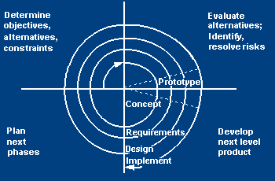
Spiral SDLC Model
Adds risk analysis, and 4gl RAD prototyping to the waterfall model
Each cycle involves the same sequence of steps as the waterfall process model

Slide 28
Spiral Quadrant Determine objectives, alternatives and constraints
Objectives: functionality, performance, hardware/software interface, critical success factors, etc.
Alternatives: build, reuse, buy, sub-contract, etc.
Constraints: cost, schedule, interface, etc.

Slide 29
Spiral Quadrant Evaluate alternatives, identify and resolve risks
Study alternatives relative to objectives and constraints
Identify risks (lack of experience, new technology, tight schedules, poor process, etc.
Resolve risks (evaluate if money could be lost by continuing system development

Slide 30
Spiral Quadrant Develop next-level product
Typical activites:
Create a design
Review design
Develop code
Inspect code
Test product

Slide 31
Spiral Quadrant Plan next phase
Typical activities
Develop project plan
Develop configuration management plan
Develop a test plan
Develop an installation plan

Slide 32
Spiral Model Strengths
Provides early indication of insurmountable risks, without much cost
Users see the system early because of rapid prototyping tools
Critical high-risk functions are developed first
The design does not have to be perfect
Users can be closely tied to all lifecycle steps
Early and frequent feedback from users
Cumulative costs assessed frequently

Slide 33
Spiral Model Weaknesses
Time spent for evaluating risks too large for small or low-risk projects
Time spent planning, resetting objectives, doing risk analysis and prototyping may be excessive
The model is complex
Risk assessment expertise is required
Spiral may continue indefinitely
Developers must be reassigned during non-development phase activities
May be hard to define objective, verifiable milestones that indicate readiness to proceed through the next iteration

Slide 34
When to use Spiral Model
When creation of a prototype is appropriate
When costs and risk evaluation is important
For medium to high-risk projects
Long-term project commitment unwise because of potential changes to economic priorities
Users are unsure of their needs
Requirements are complex
New product line
Significant changes are expected (research and exploration)

Slide 35
Agile SDLC’s
Speed up or bypass one or more life cycle phases
Usually less formal and reduced scope
Used for time-critical applications
Used in organizations that employ disciplined methods

Slide 36
Some Agile Methods
Adaptive Software Development (ASD)
Feature Driven Development (FDD)
Crystal Clear
Dynamic Software Development Method (DSDM)
Rapid Application Development (RAD)
Scrum
Extreme Programming (XP)
Rational Unify Process (RUP)

Slide 37
Extreme Programming - XP
For small-to-medium-sized teams developing software with vague or rapidly changing requirements
Coding is the key activity throughout a software project
Communication among teammates is done with code
Life cycle and behavior of complex objects defined in test cases – again in code

Slide 38
XP Practices (1-6)
Planning game – determine scope of the next release by combining business priorities and technical estimates
Small releases – put a simple system into production, then release new versions in very short cycle
Metaphor – all development is guided by a simple shared story of how the whole system works
Simple design – system is designed as simply as possible (extra complexity removed as soon as found)
Testing – programmers continuously write unit tests; customers write tests for features
Refactoring – programmers continuously restructure the system without changing its behavior to remove duplication and simplify

Slide 39
XP Practices (7 – 12)
Pair-programming -- all production code is written with two programmers at one machine
Collective ownership – anyone can change any code anywhere in the system at any time.
Continuous integration – integrate and build the system many times a day – every time a task is completed.
40-hour week – work no more than 40 hours a week as a rule
On-site customer – a user is on the team and available full-time to answer questions
Coding standards – programmers write all code in accordance with rules emphasizing communication through the code

Slide 40
XP is “extreme” because
Commonsense practices taken to extreme levels
If code reviews are good, review code all the time (pair programming)
If testing is good, everybody will test all the time
If simplicity is good, keep the system in the simplest design that supports its current functionality. (simplest thing that works)
If design is good, everybody will design daily (refactoring)
If architecture is important, everybody will work at defining and refining the architecture (metaphor)
If integration testing is important, build and integrate test several times a day (continuous integration)
If short iterations are good, make iterations really, really short (hours rather than weeks)

Slide 41
XP References
Online references to XP at
http://www.extremeprogramming.org/
http://c2.com/cgi/wiki?ExtremeProgrammingRoadmap
http://www.xprogramming.com/

Slide 42
Feature Driven Design (FDD)
Five FDD process activities
Develop an overall model – Produce class and sequence diagrams from chief architect meeting with domain experts and developers.
Build a features list – Identify all the features that support requirements. The features are functionally decomposed into Business Activities steps within Subject Areas.
Features are functions that can be developed in two weeks and expressed in client terms with the template: <action> <result> <object>
i.e. Calculate the total of a sale
Plan by feature -- the development staff plans the development sequence of features
Design by feature -- the team produces sequence diagrams for the selected features
Build by feature – the team writes and tests the code
http://www.nebulon.com/articles/index.html

Slide 43
Dynamic Systems Development Method (DSDM)
Applies a framework for RAD and short time frames
Paradigm is the 80/20 rule
– majority of the requirements can be delivered in a relatively short amount of time.

Slide 44
DSDM Principles
Active user involvement imperative (Ambassador users)
DSDM teams empowered to make decisions
Focus on frequent product delivery
Product acceptance is fitness for business purpose
Iterative and incremental development - to converge on a solution
Requirements initially agreed at a high level
All changes made during development are reversible
Testing is integrated throughout the life cycle
Collaborative and co-operative approach among all stakeholders essential

Slide 45
DSDM Lifecycle
Feasibility study
Business study – prioritized requirements
Functional model iteration
risk analysis
Time-box plan
Design and build iteration
Implementation

Slide 46
Adaptive SDLC
Combines RAD with software engineering best practices
Project initiation
Adaptive cycle planning
Concurrent component engineering
Quality review
Final QA and release

Slide 47
Adaptive Steps
Project initialization – determine intent of project
Determine the project time-box (estimation duration of the project)
Determine the optimal number of cycles and the time-box for each
Write an objective statement for each cycle
Assign primary components to each cycle
Develop a project task list
Review the success of a cycle
Plan the next cycle

Slide 48
Tailored SDLC Models
Any one model does not fit all projects
If there is nothing that fits a particular project, pick a model that comes close and modify it for your needs.
Project should consider risk but complete spiral too much – start with spiral & pare it done
Project delivered in increments but there are serious reliability issues – combine incremental model with the V-shaped model
Each team must pick or customize a SDLC model to fit its project

Slide 49
Agile Web references
DePaul web site has links to many Agile references
http://se.cs.depaul.edu/ise/agile.htm

Slide 50
Quality – the degree to which the software satisfies stated and implied requirements
Absence of system crashes
Correspondence between the software and the users’ expectations
Performance to specified requirements
Quality must be controlled because it lowers production speed, increases maintenance costs and can adversely affect business

Slide 51
Quality Assurance Plan
The plan for quality assurance activities should be in writing
Decide if a separate group should perform the quality assurance activities
Some elements that should be considered by the plan are: defect tracking, unit testing, source-code tracking, technical reviews, integration testing and system testing.

Slide 52
Quality Assurance Plan
Defect tracing – keeps track of each defect found, its source, when it was detected, when it was resolved, how it was resolved, etc
Unit testing – each individual module is tested
Source code tracing – step through source code line by line
Technical reviews – completed work is reviewed by peers
Integration testing -- exercise new code in combination with code that already has been integrated
System testing – execution of the software for the purpose of finding defects.

